Slide 1


車用電子期末報告
Introduction to Autotronics System Design
Traffic sign recoginition on Raspberry Pi
組員:、鄭珮甄、陳柏旭、陳晉弘、簡唯耕、郭文琪、陳其宏

Slide 2
目 錄
contents
介紹
結論
Introduction
Conclusion
相關作品
方法
Related Work
Method

Slide 3
Introduction

Slide 4
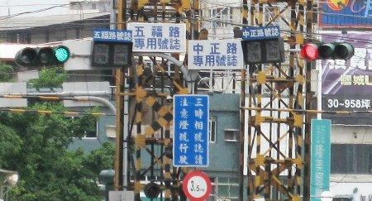
Introduction
Introduction
Traffic sign recognition system is a crucial research direction in computer vision and it has high industrial potential in Driver Assistant System and Intelligent Autonomous Vehicles.
Applications, among others, include advanced driver assistance systems(ADAS), sign inventory , autonomous driving.

Slide 5
Introduction
Introduction
However, there are many difficulties for identifying traffic signs by computer algorithms due to illumination changes, color deterioration, motion blur, cluttered background and partial occlusion, etc.
We used raspberry pi and camera to detect the traffic sign and show on the screen.

Slide 6
Related Work

Slide 7
Related Work
C
SLP methods
Manual feature methods
A traffic sign recognition system that is composed of two main phases, which are shape classification and content classification, was proposed. For shape classification, the shape of the bounded object is determined by MLP. As for content classification, a Single-Layer Perceptron is leveraged to determine the symbol of the traffic sign.
Manual labeling not only increased the workload, but also the accuracy rate was difficult to guarantee.
A
Deep learning methods
Artificial feature learning methods generally use random forest, but this method is not easy to recognize for images with blurred feature boundaries
B
SVM methods
D
A traffic sign recognition system based on the generalization properties of support vector machines (SVMs) was proposed. The work segments the traffic sign from the images. Some geometric shape related features such as size, ratio, or shape are analysed. Classification is then performed using linear SVMs with Gaussian kernels. Different one-versus-all SVMs classifiers were used for every colour and shape.

Slide 8
Method

Slide 9

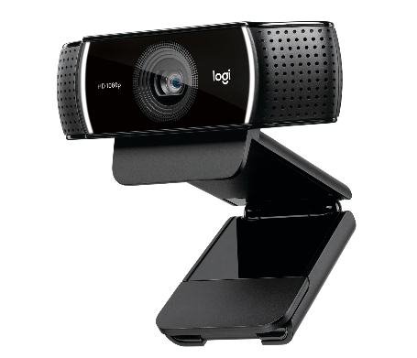

Method
Hardware Equipment
1.Rasberry pi 3 model B+:
CPU: 1.4GHz Quad-Core ARM Cortex-A53 (64Bit)
GPU: Broadcom VideoCore IV, OpenGL ES 2.0,
1080p30 H.264 high-profile decode
RAM: 1GB LPDDR2
2.C922 Pro:
Full HD 1080p Streaming
720p Streaming at 60 fps
Brighter Images
Full Stereophonics
All-in-One Content Creation with Capture

Slide 10
Method
Hardware Equipment
3.Traffic sign:
Stop
Right
Left

Slide 11
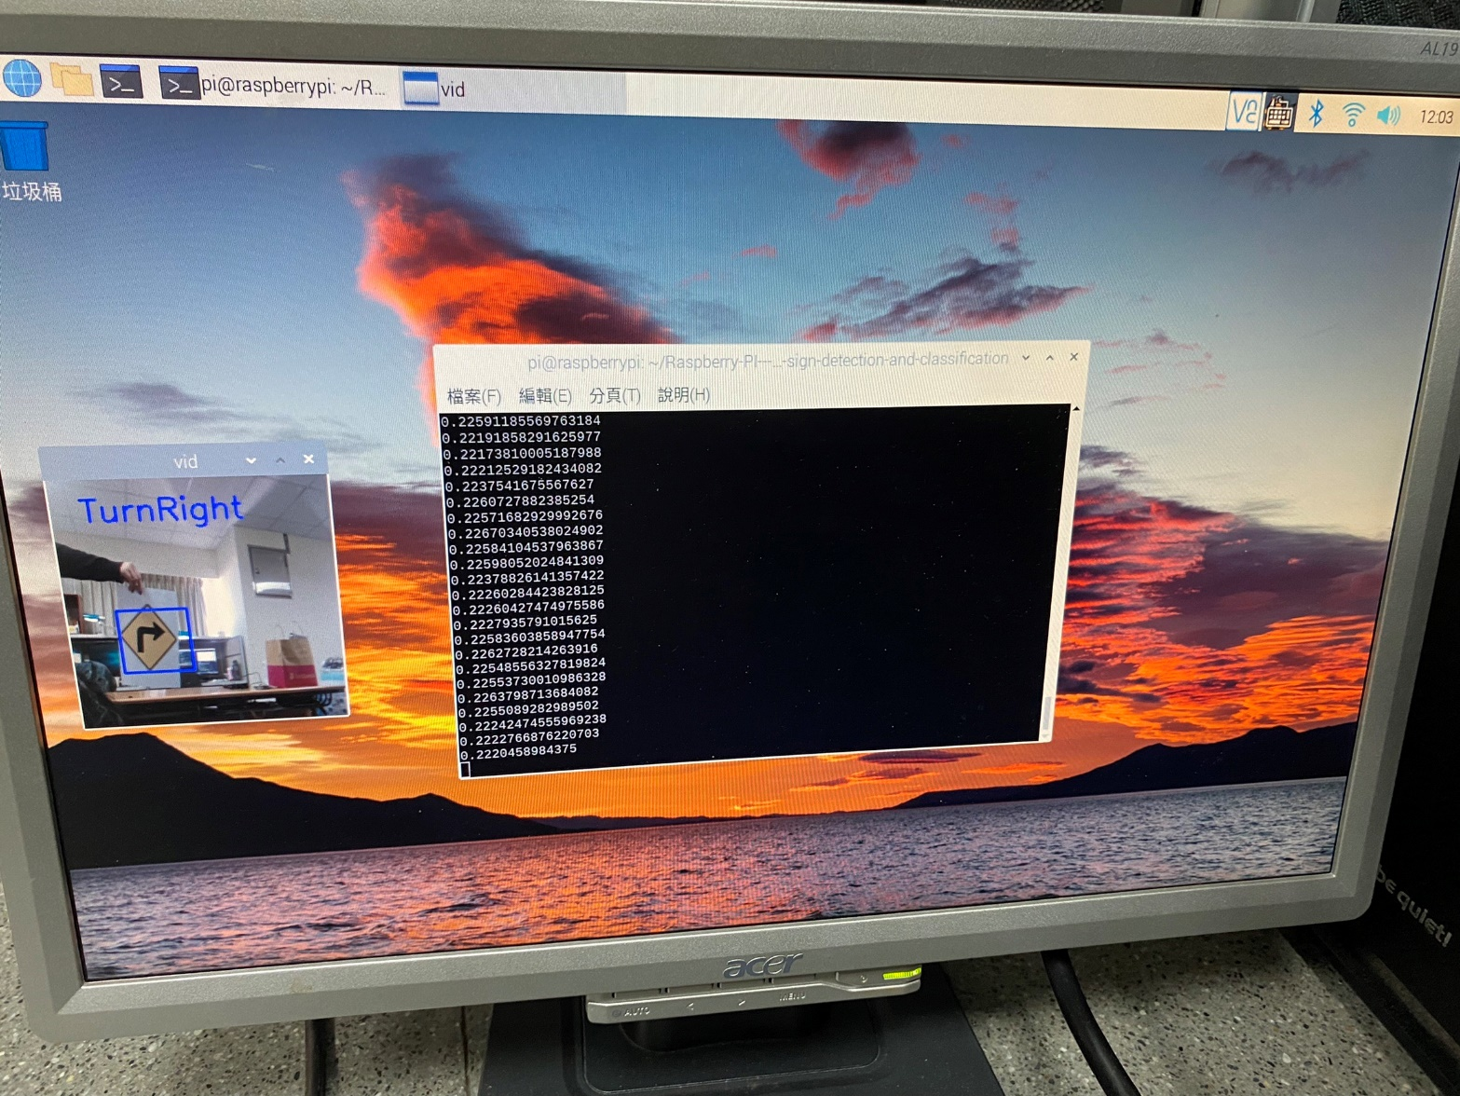
Method
Template matching algorithm
Template matching is a technique in digital image processing for finding small parts of an image which match a template image. It can be used in manufacturing as a part of quality control, a way to navigate a mobile robot, or as a way to detect edges in images.
The main challenges in the template matching task are: occlusion, detection of non-rigid transformations, illumination and background changes, background clutter and scale changes.

Slide 12
Method
Why we don’t use Yolo and CNN?
We have tried to use YOLO to train but the raspberry pi floating point from 900 MHZ to 1200 MHZ.
The real-time performance was unacceptable, so instead of convolution neural network, we worked on another solution which is TMA.

Slide 13
Method
What we need to pay attention to?
Cv2.matchedTemplate function must to be gray so we converted the input images.
After trial-and-error, we found the threshold value that gives the best accuracy is equal to 0.5.

Slide 14
Conclusion

Slide 15
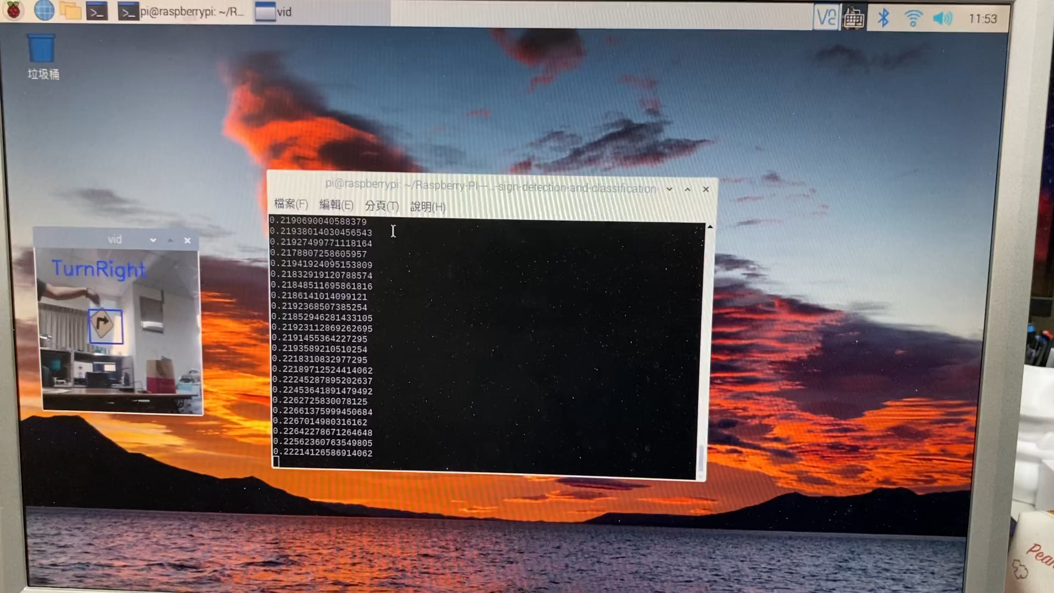
Conclusion
Demo

Slide 16
References
M. A. Vincent, V. K. R and S. P. Mathew, "Traffic Sign Classification Using Deep Neural Network," 2020 IEEE Recent Advances in Intelligent Computational Systems (RAICS), 2020, pp. 13-17, doi: 10.1109/RAICS51191.2020.9332474.
Z. He, Z. Xiao and Z. Yan, "Traffic Sign Recognition Based on Convolutional Neural Network Model," 2020 Chinese Automation Congress (CAC), 2020, pp. 155-158, doi: 10.1109/CAC51589.2020.9327830.
K. Fu, I. Y. H. Gu, A. Ödblom and Feng Liu, "Geodesic distance transform-based salient region segmentation for automatic traffic sign recognition," 2016 IEEE Intelligent Vehicles Symposium (IV), 2016, pp. 948-953, doi: 10.1109/IVS.2016.7535502.
Y. Sun, P. Ge and D. Liu, "Traffic Sign Detection and Recognition Based on Convolutional Neural Network," 2019 Chinese Automation Congress (CAC), 2019, pp. 2851-2854, doi: 10.1109/CAC48633.2019.8997240.
Y. Yang, H. Luo, H. Xu and F. Wu, "Towards Real-Time Traffic Sign Detection and Classification," in IEEE Transactions on Intelligent Transportation Systems, vol. 17, no. 7, pp. 2022-2031, July 2016, doi: 10.1109/TITS.2015.2482461.
Z. B. Ng, K. Ming Lim and C. P. Lee, "Traffic Sign Recognition with Convolutional Neural Network," 2021 9th International Conference on Information and Communication Technology (ICoICT), 2021, pp. 48-53, doi: 10.1109/ICoICT52021.2021.9527505.

Slide 17
Thanks for listening
組員:、鄭珮甄、陳柏旭、陳晉弘、簡唯耕、郭文琪、陳其宏

